Slide 1
Design Project Organizations
Presented by Tiancheng Ge

Slide 2





Lots of Design Project Organizations on Campus!
Super Mileage
M-FLY
BAJA Racing
Solar Car
M Racing
…

Slide 3
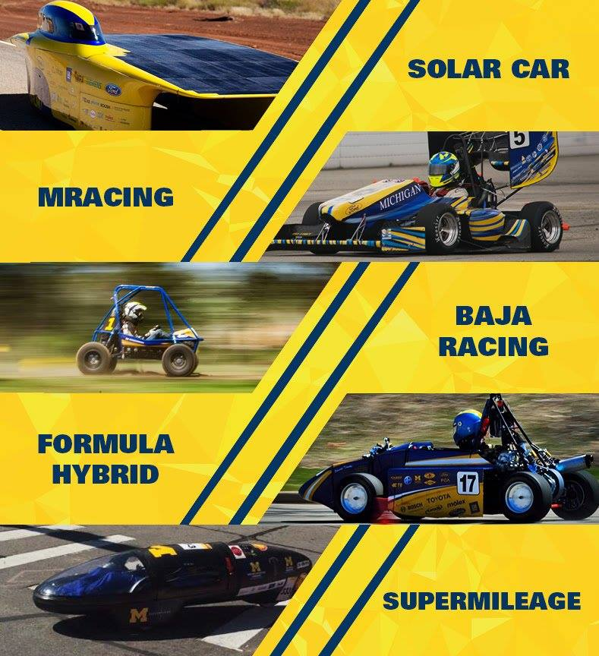
Most of them attend competitions
and involve racing…
https://www.facebook.com/umsolar/photos/a.10150582937690228.674427.65547195227/10157312960810228/?type=3&theater

Slide 4
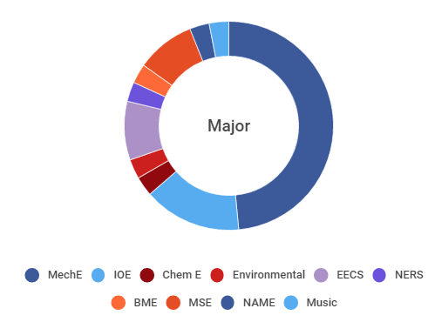
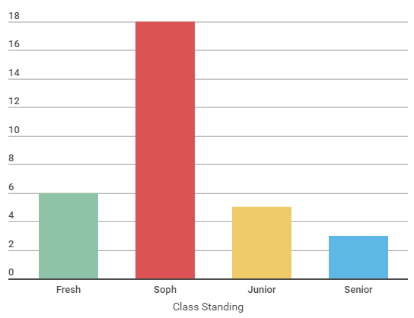
Majors and Class Standing in the Team?
For Supermileage:
http://umsm.engin.umich.edu/?page_id=382

Slide 5
Majors and Class Standing in the Team?
Both EECS, ME students can find their role in the team. (Circuit design and coding for EECS, structure design and mechanical analysis for ME)
Needn’t be too worried about the difficulty of the work, since all levels of students can join the team.

Slide 6
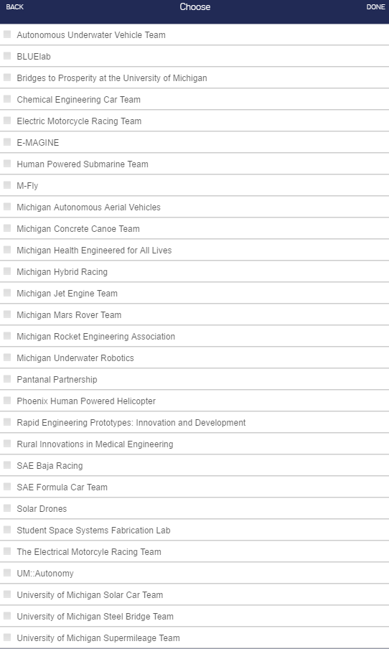
The Outcomes
Team experience
Resume…
A special section on ENGenuis.jobs to fill in the team experience

Slide 7
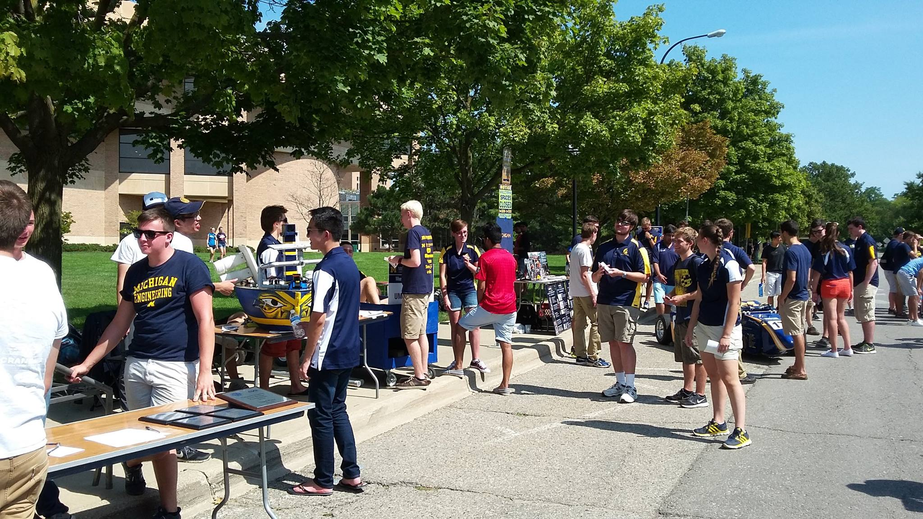
How to choose the team?
Attend Northfest/Festifall
They are at the beginning of the semester, similar to “The War of Hundreds of Clubs” at SJTU…)
If you’ve enrolled in the Bubby program, you can let your accompany you during the event, give his/her opinions on the teams. You’ll get a brief idea what each team does.

Slide 8
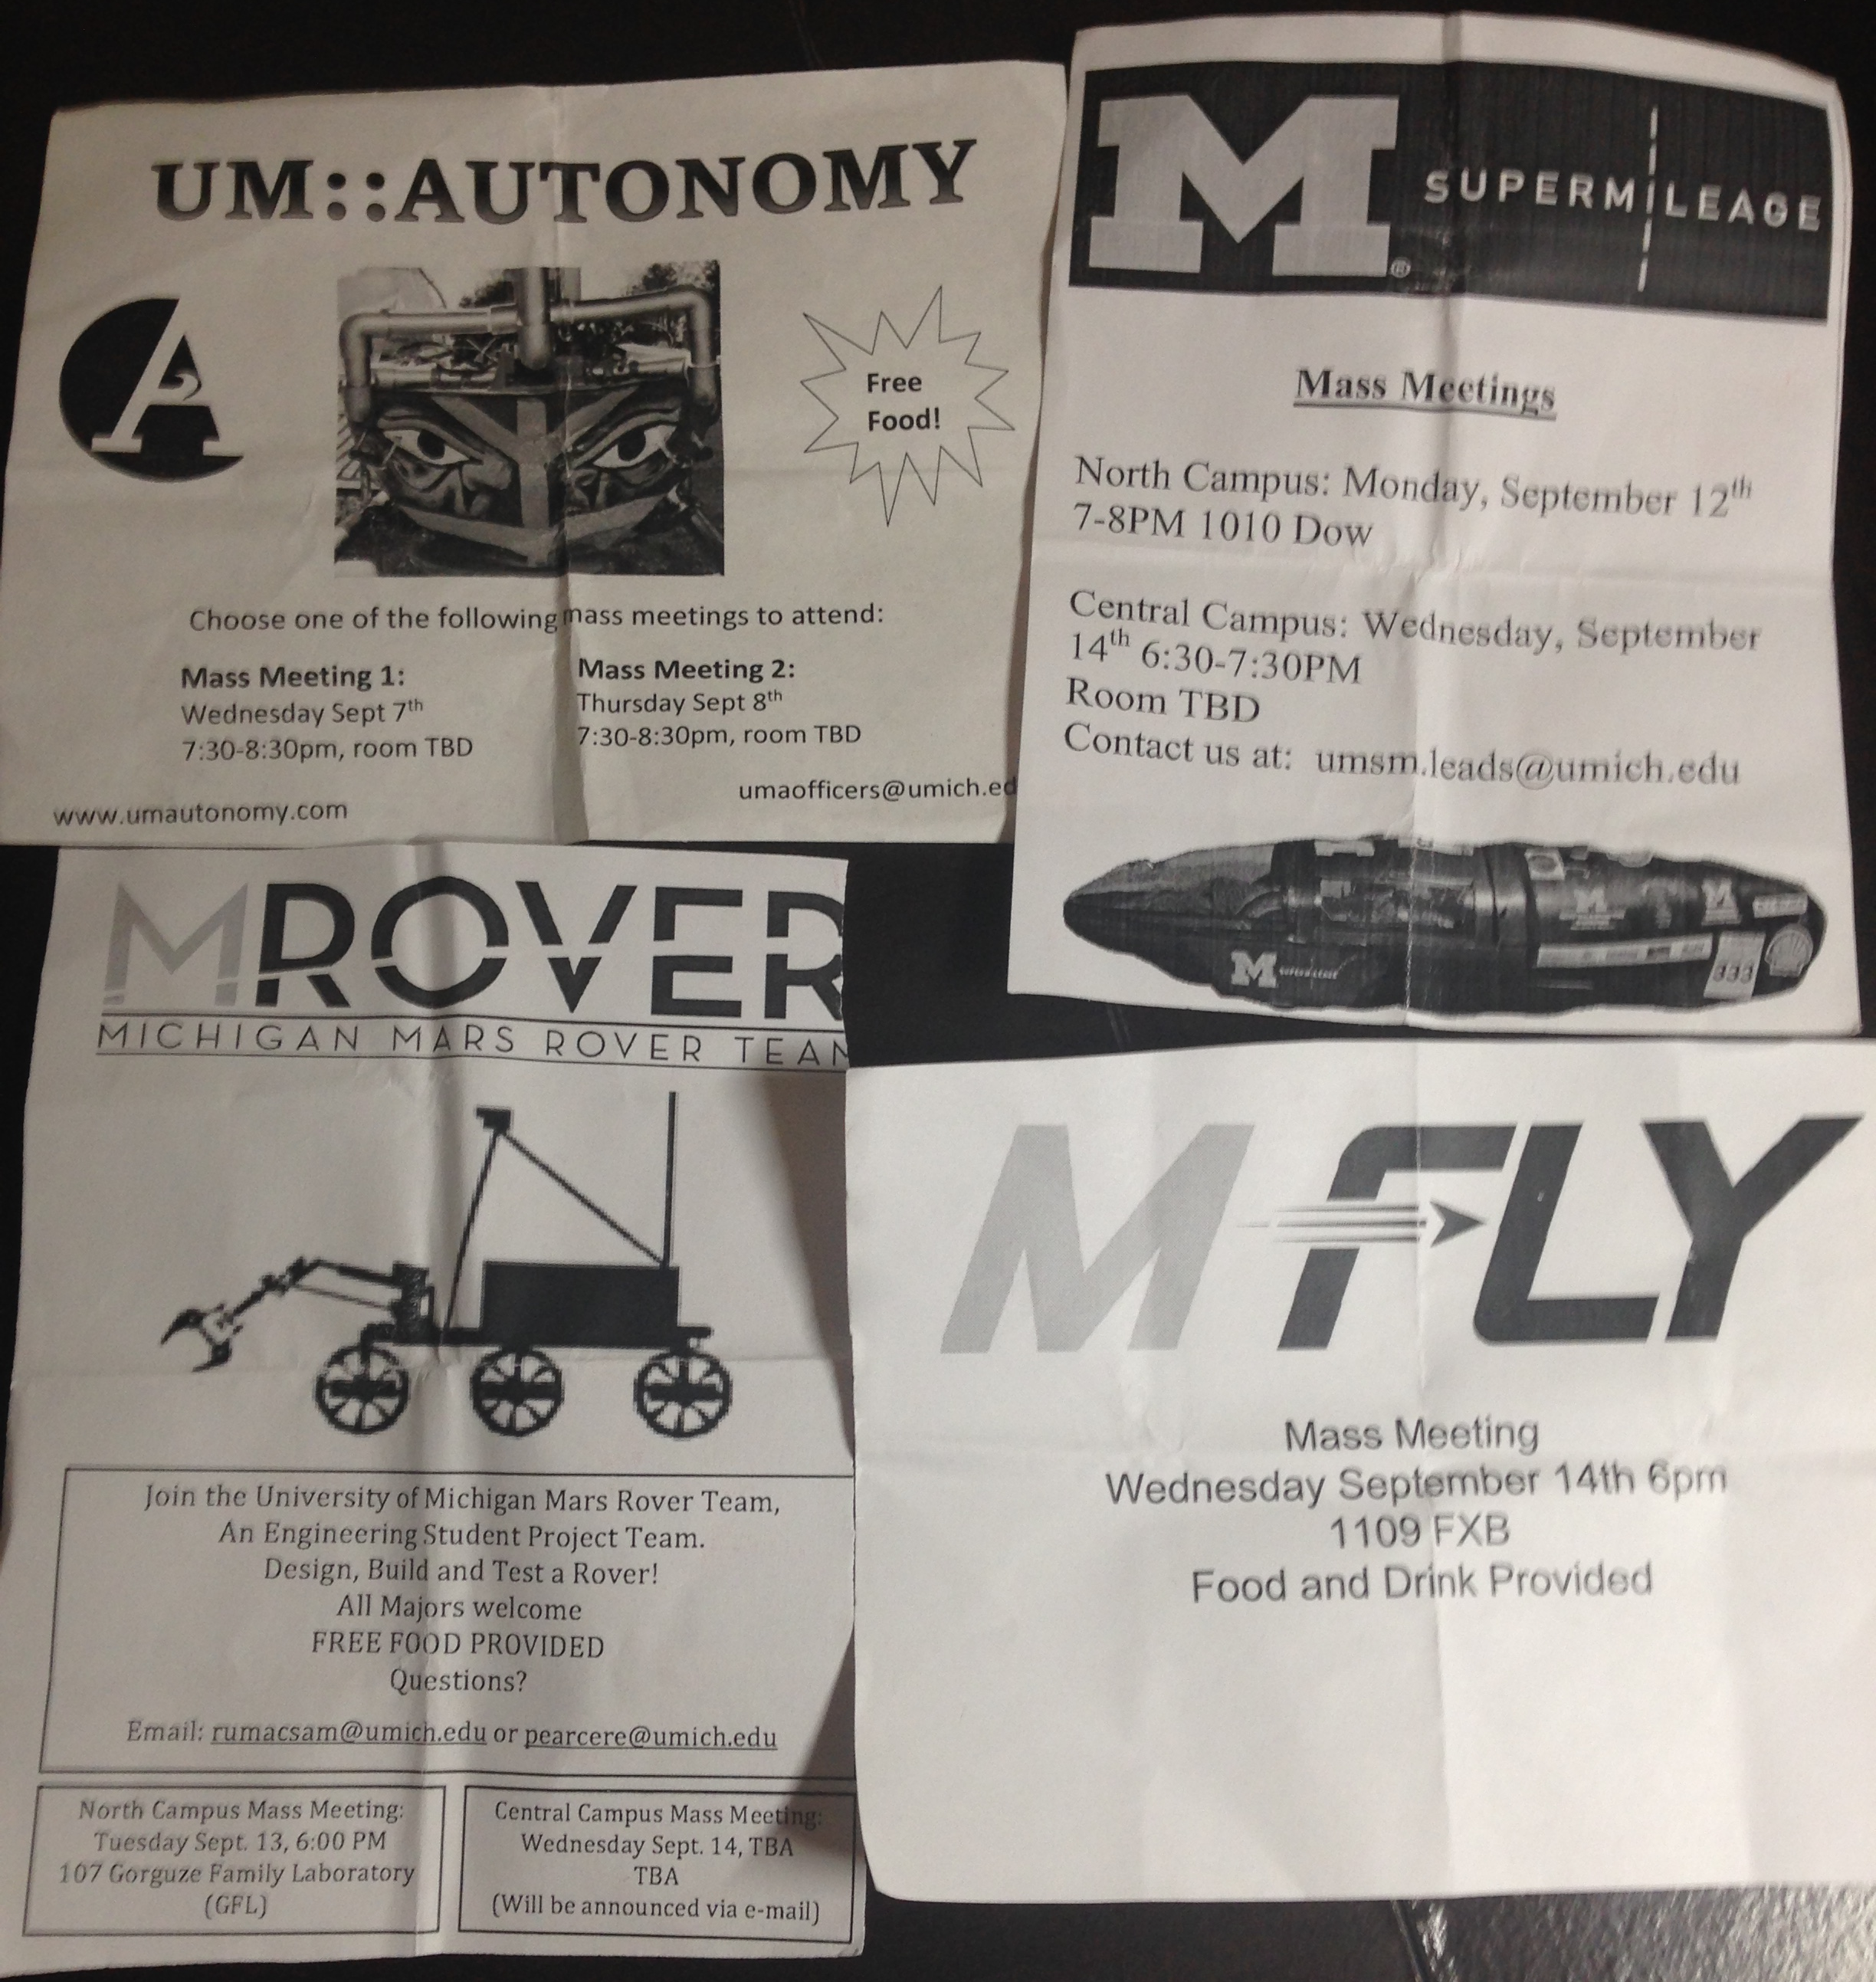
Mass Meetings
During Northfest/Festifall, you’ll get such small files that state the time for mass meeting, a place to develop a deeper understand of each team.
By the due date of the report, none of the teams have held the mass meeting, and the recruiting hasn’t started yet.

Slide 9
Some gossips from my buddy, who is a member of SAE
The time works in a team per week varies, depending on the role in the team, from 10hr to 30hr…
Although solar car seems very ME-ish, most changes in it are electrical part, so EECS students may fits more in the team…

Slide 10
Further details may be provided after I actually join one team…

Slide 11
References
[1] PPT Template: http://studentorgs.engin.umich.edu/wp-content/uploads/sites/16/2013/06/Student-Organization-Leaders-Presentation-Fall-2014.ppt.
[2] http://umsm.engin.umich.edu/?page_id=382
[3] http://engineering-umich-csm.symplicity.com

